Slide 1


Getting Started – Hello world
Build a basic with

Slide 2
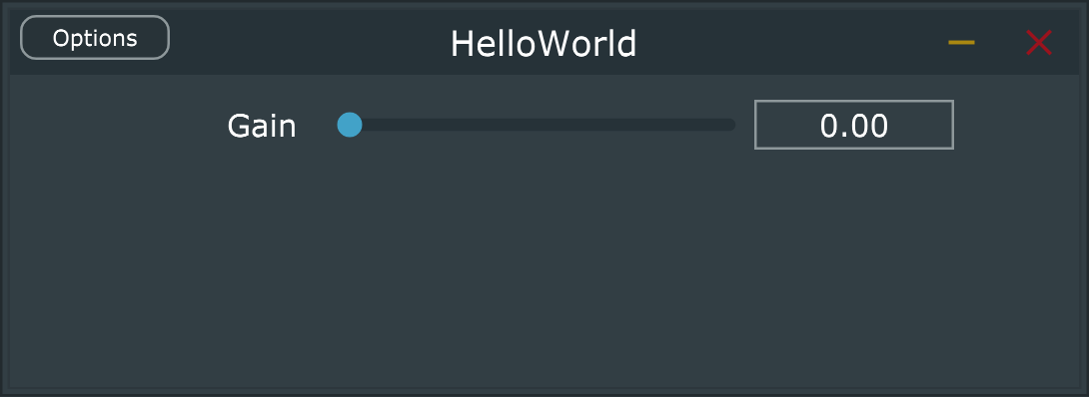
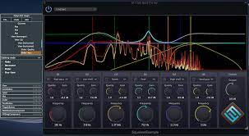
Beyond the generic user interface
Generic UI only intended for prototyping
Lets make a real UI
Add a control
Add a parameter value based on the control
Have a way to update the parameter when the control is changed
Show the control on the interface
Use the parameter somehow

Slide 3
Add a slider
Generic UI only intended for prototyping
Go back to HelloWorld before generic UI
Add a slider in pluginEditor.h
Add a float in pluginProcessor
class NewProjectAudioProcessorEditor : public juce::AudioProcessorEditor, private Slider::Listener
{
…
private:
Slider gainSlider;
class NewProjectAudioProcessor : public juce::AudioProcessor
...
{
…
float gainParam = 0.1f;
private:

Slide 4
Changing the slider
Generic UI only intended for prototyping
Go back to HelloWorld before generic UI
Add a function in the editor
//PluginEditor.h
void sliderValueChanged(Slider* slider);
//PluginEditor.cpp
void NewProjectAudioProcessorEditor::sliderValueChanged(Slider* slider)
{
audioProcessor.gainParam = gainSlider.getValue();
}

Slide 5
Put the slider on the interface
Now edit the constructor in pluginEditor.cpp
And edit resized
NewProjectAudioProcessorEditor::NewProjectAudioProcessorEditor (NewProjectAudioProcessor& p)
: AudioProcessorEditor (&p), audioProcessor (p)
{
setSize (400, 300);
gainSlider.setRange(0.0, 1.0, 0.01);
gainSlider.setValue(0.5);
gainSlider.setTextBoxStyle(Slider::TextBoxLeft, false, 60, 30);
addAndMakeVisible(&gainSlider);
gainSlider.addListener(this);
}
void NewProjectAudioProcessorEditor::resized()
{
gainSlider.setBounds(40, 30, 160, 50);
}

Slide 6
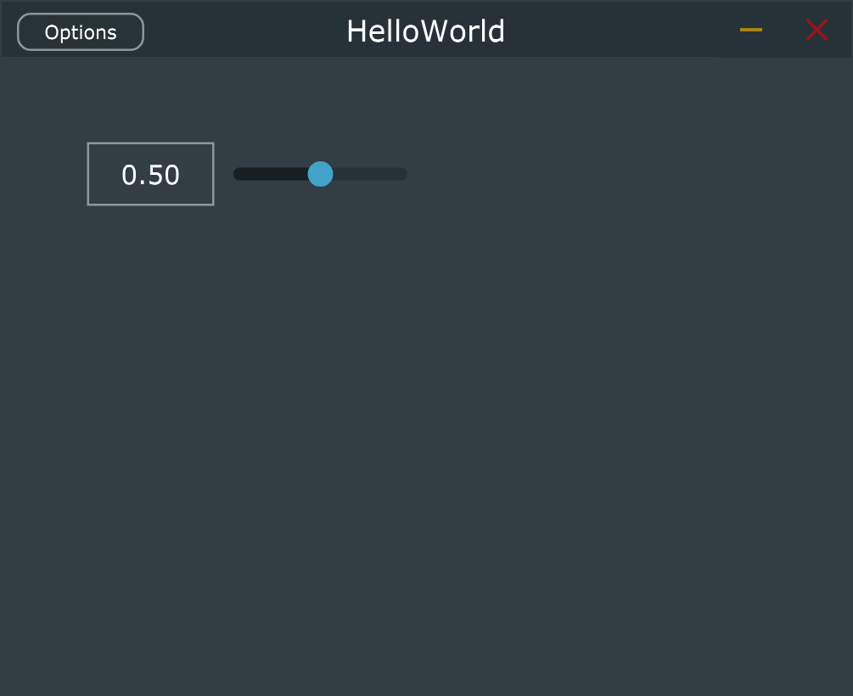
Use the slider
We now have a slider on the interface ☺
So far, this gain slider doesn’t do anything.
Modify the code in the processBlock to be
void NewProjectAudioProcessor::processBlock (juce::AudioBuffer<float>& buffer, juce::MidiBuffer& midiMessages)
{
auto totalNumOutputChannels = getTotalNumOutputChannels();
for (int channel = 0; channel < totalNumOutputChannels; ++channel)
{
auto* channelData = buffer.getWritePointer (channel);
for (int i = 0; i < buffer.getNumSamples(); i++) {
channelData[i] = gainParam * (2 * (float)rand() / RAND_MAX - 1);
}
}
}

